Slide 1
K8s Quick Start
Bohdan Benetskyi · bbenetskyy - Github

Slide 2
Agenda
What is K8s
Why and for what we should use it?
Short about Master
Something about Nodes
Pods Theory & Demo
RC/SVC Theory & Demo
Deployments Theory & Demo
Some Additional Comparison Slides

Slide 3
What is K8s

Slide 4
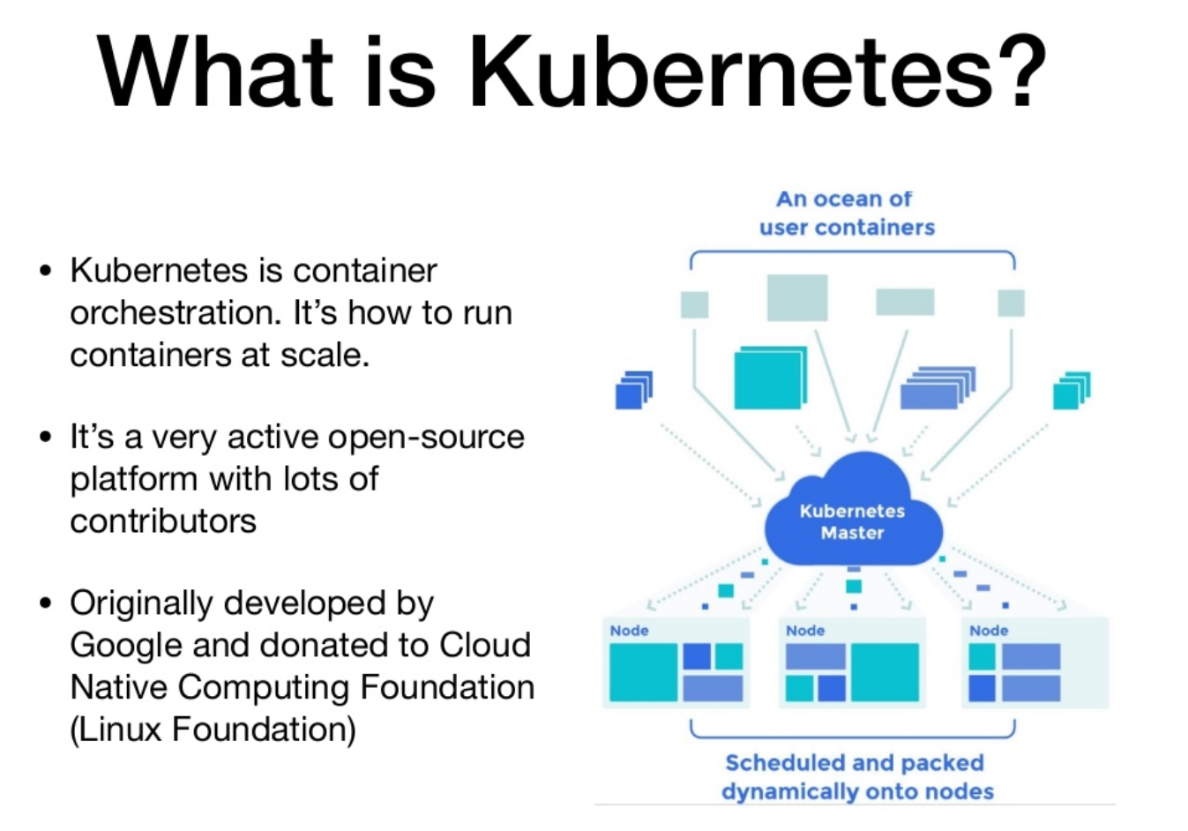
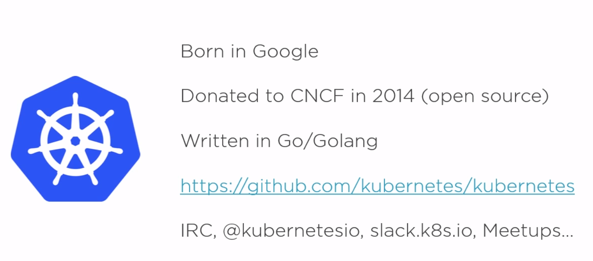

Kubernetes Wiki
Kubernetes Github
What is K8s

Slide 5


What is K8s

Slide 6
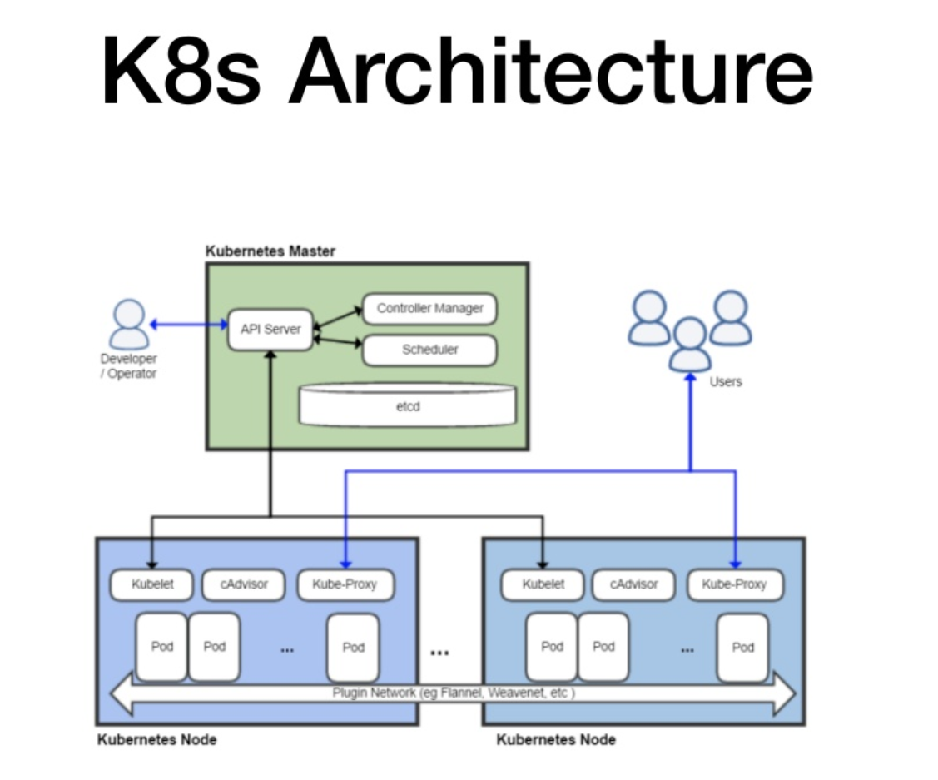
What is K8s

Slide 7
Why and for what we should use it?

Slide 8
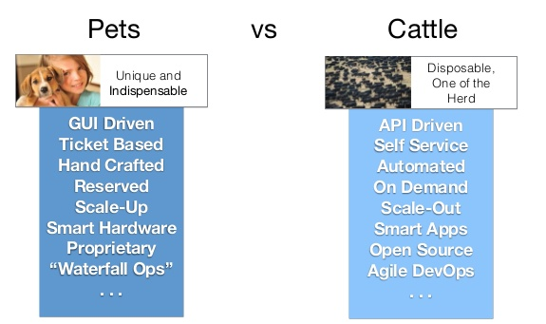

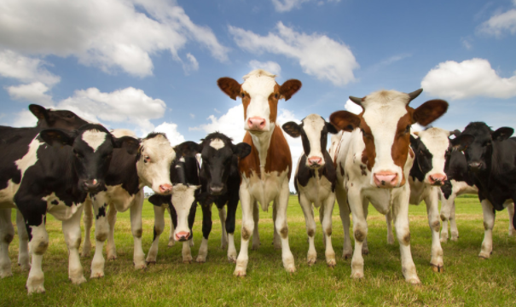
Why and for what we should use it?

Slide 9
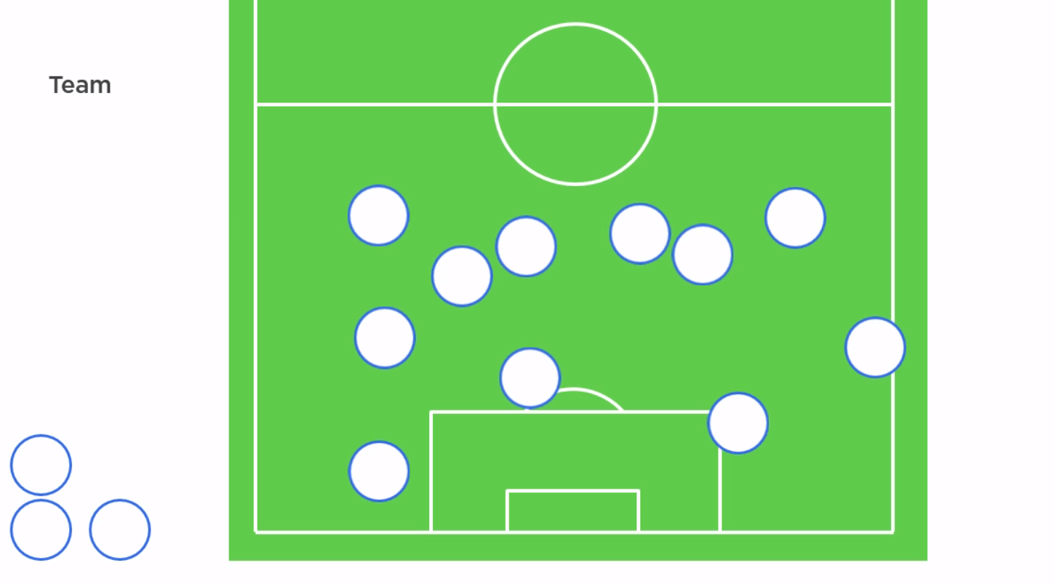
Why and for what we should use it?

Slide 10
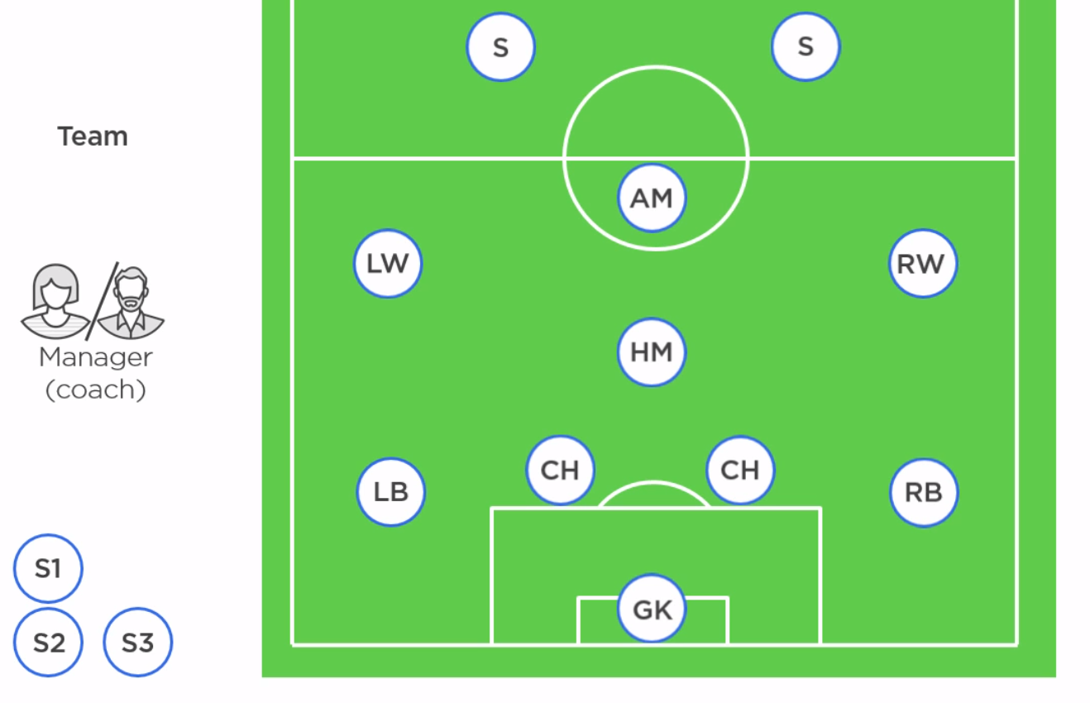
Why and for what we should use it?

Slide 11
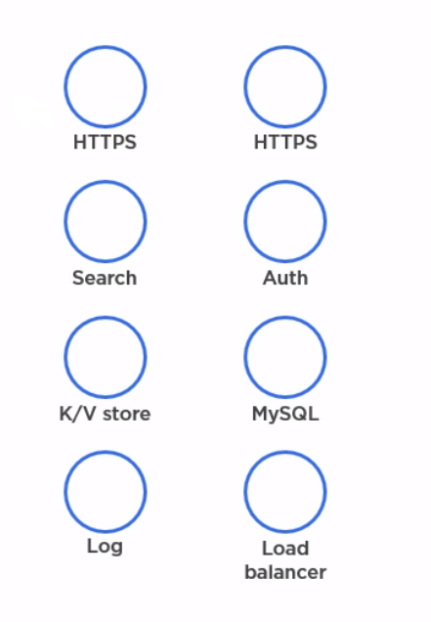
orchestration
Why and for what we should use it?

Slide 12
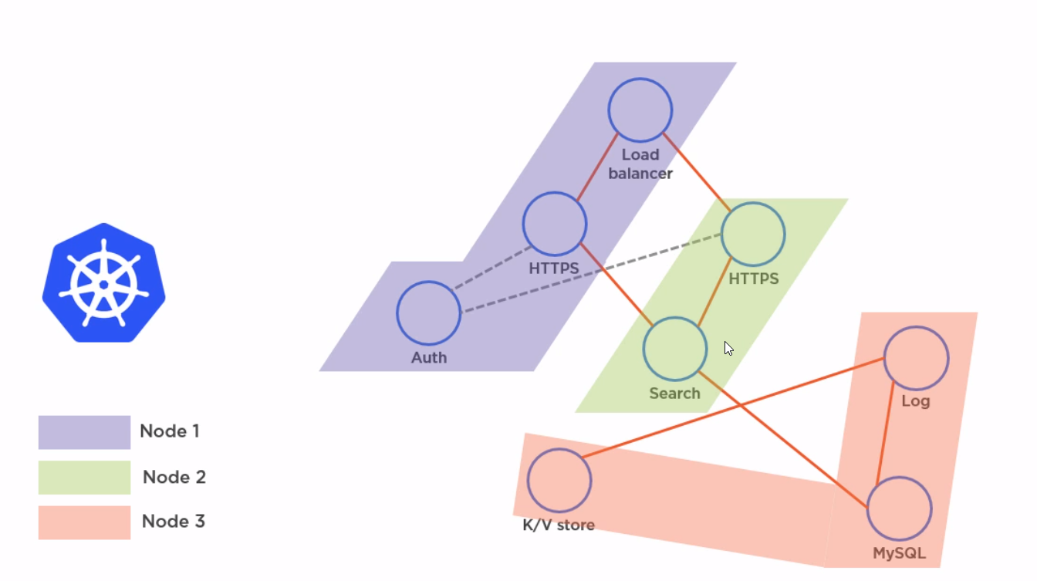
Why and for what we should use it?

Slide 13
Short about Master

Slide 14

Why and for what we should use it?

Slide 15
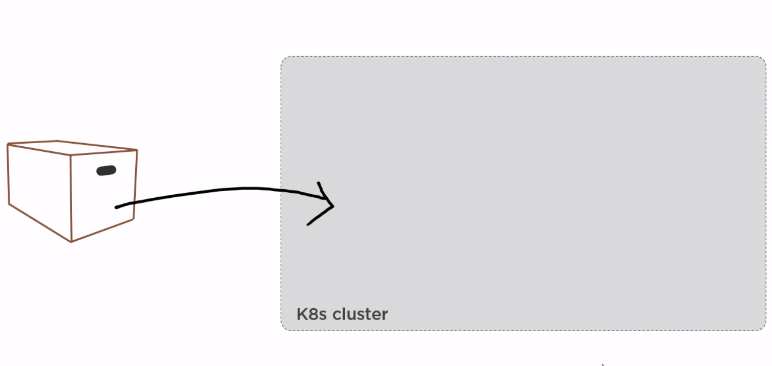
Why and for what we should use it?

Slide 16
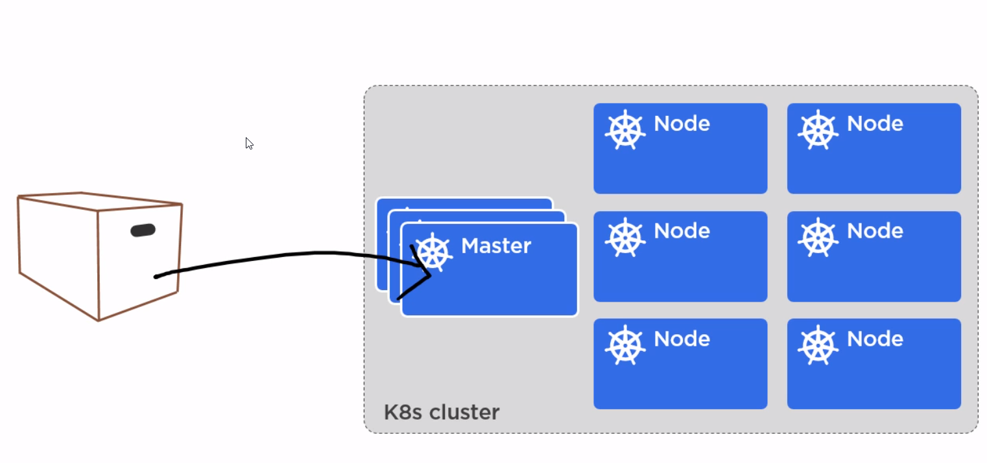
Why and for what we should use it?

Slide 17
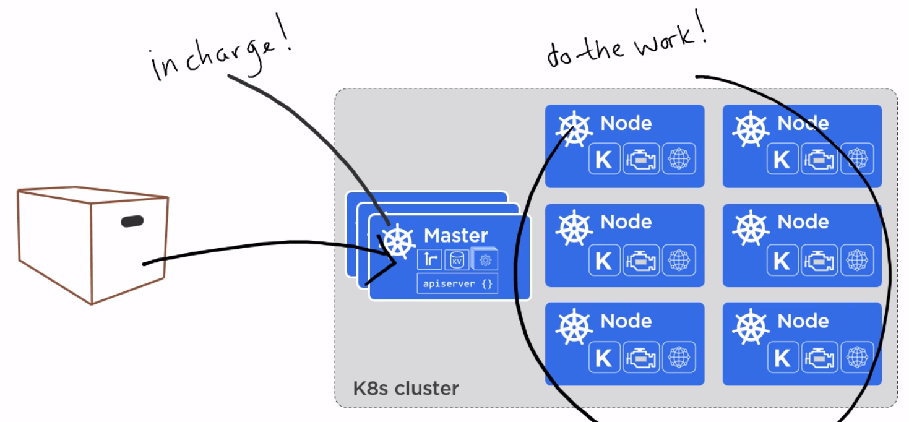
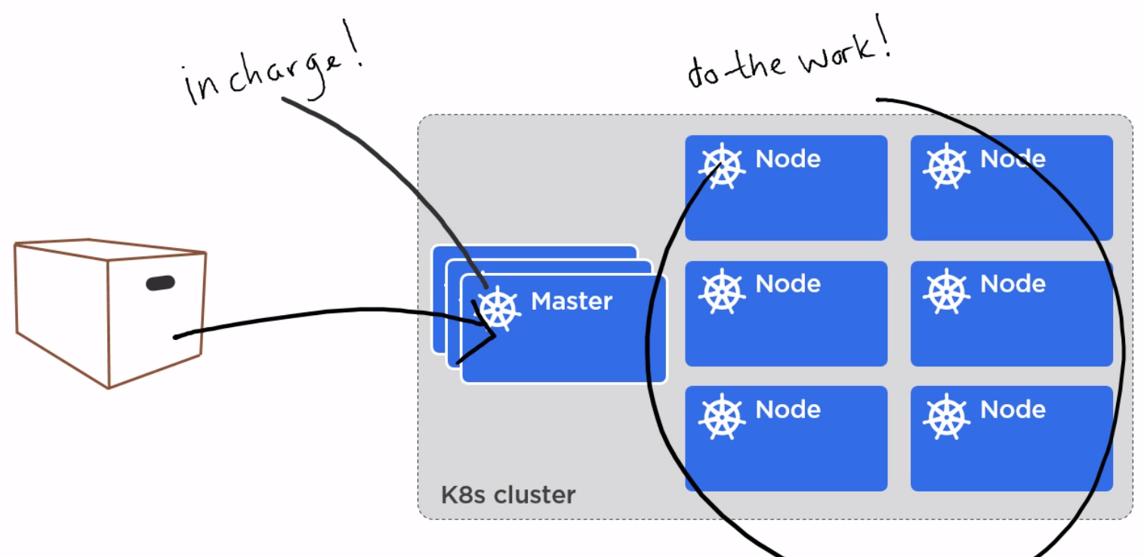
Why and for what we should use it?

Slide 18
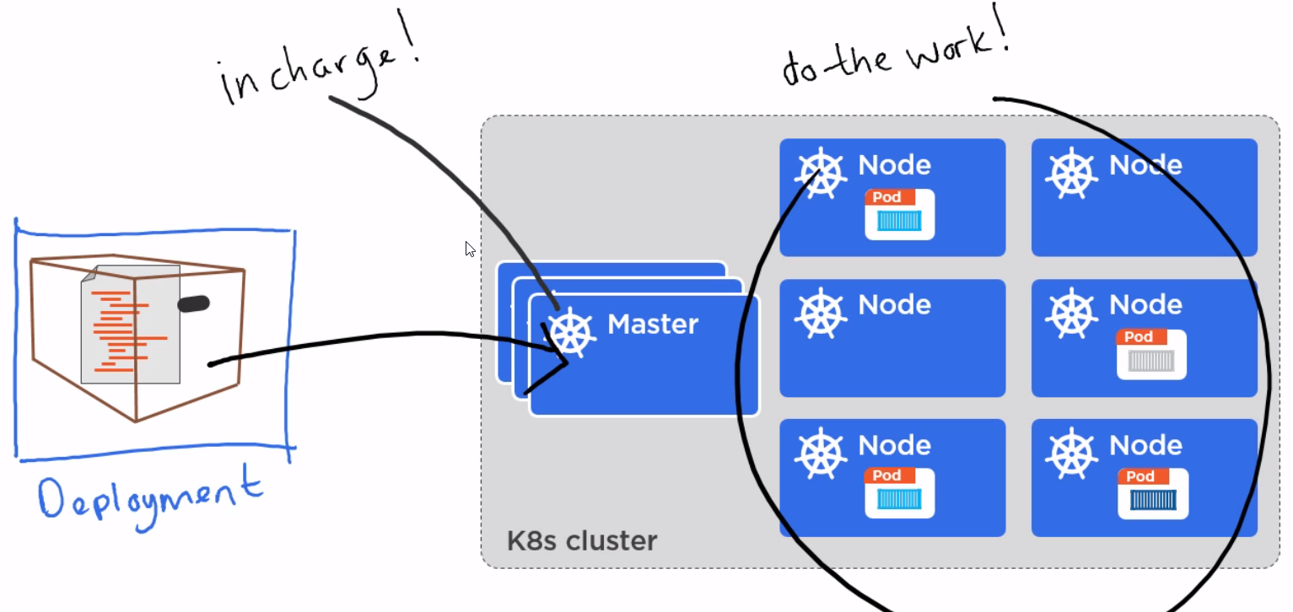
Why and for what we should use it?

Slide 19
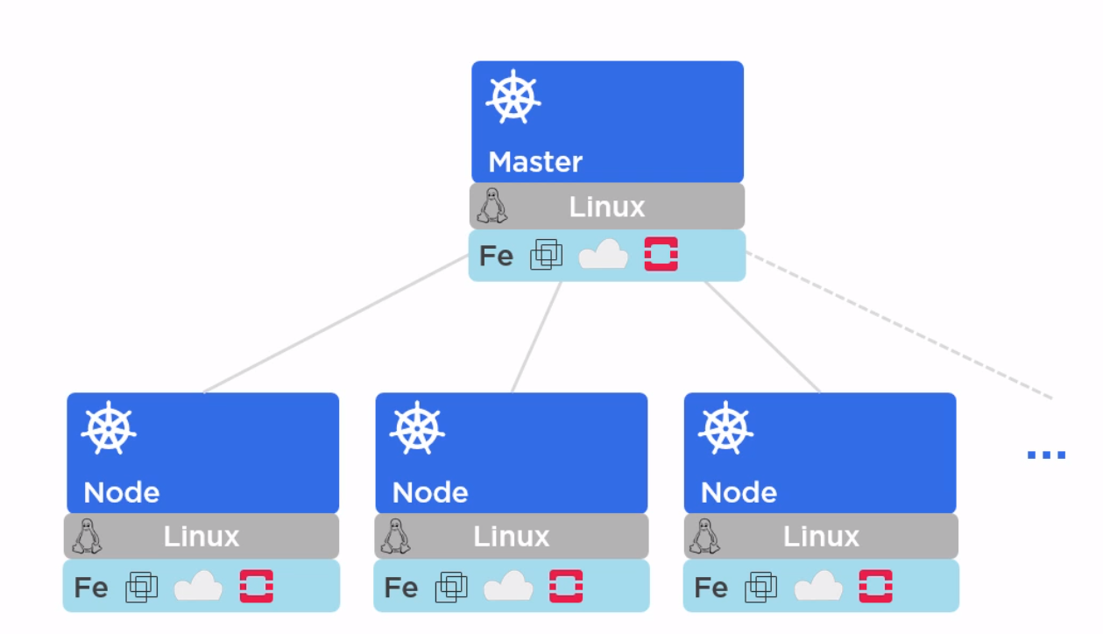
Short about Master

Slide 20
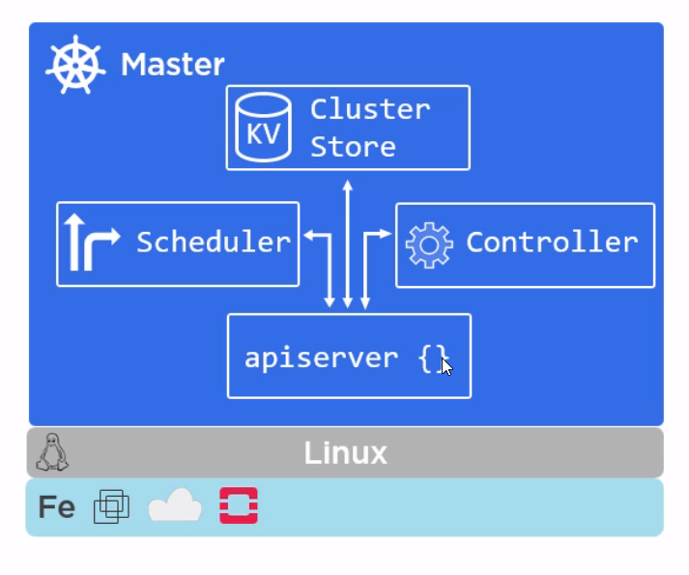
Short about Master

Slide 21
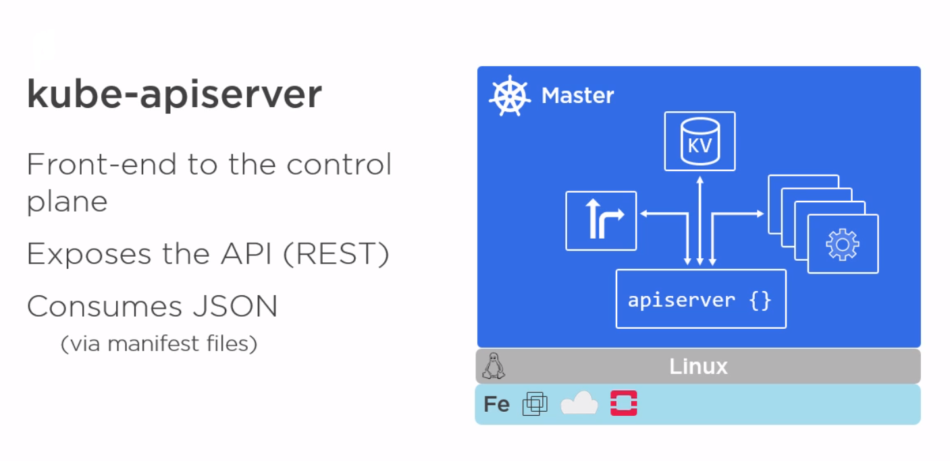

Short about Master

Slide 22
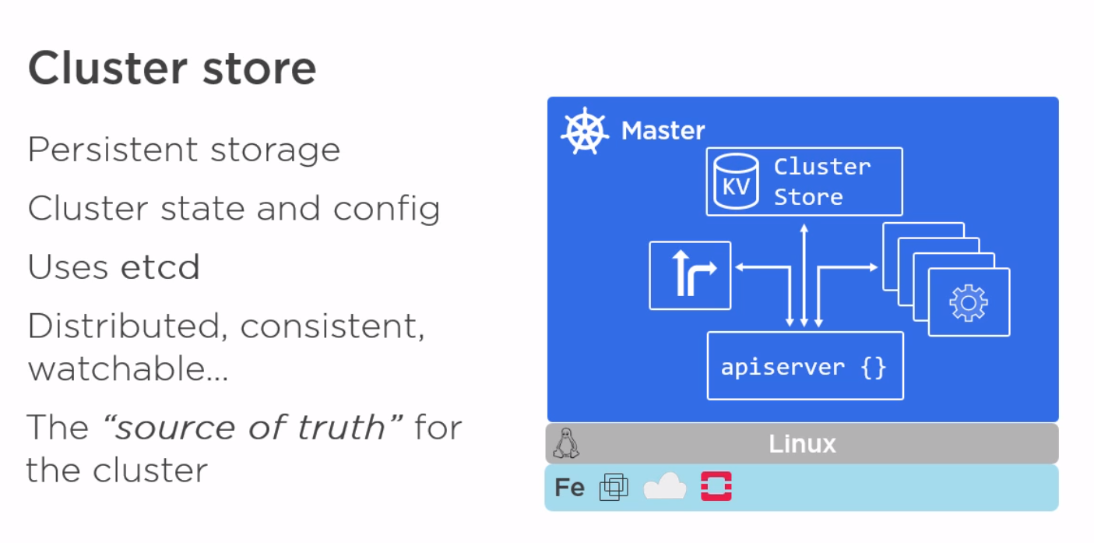
Short about Master

Slide 23
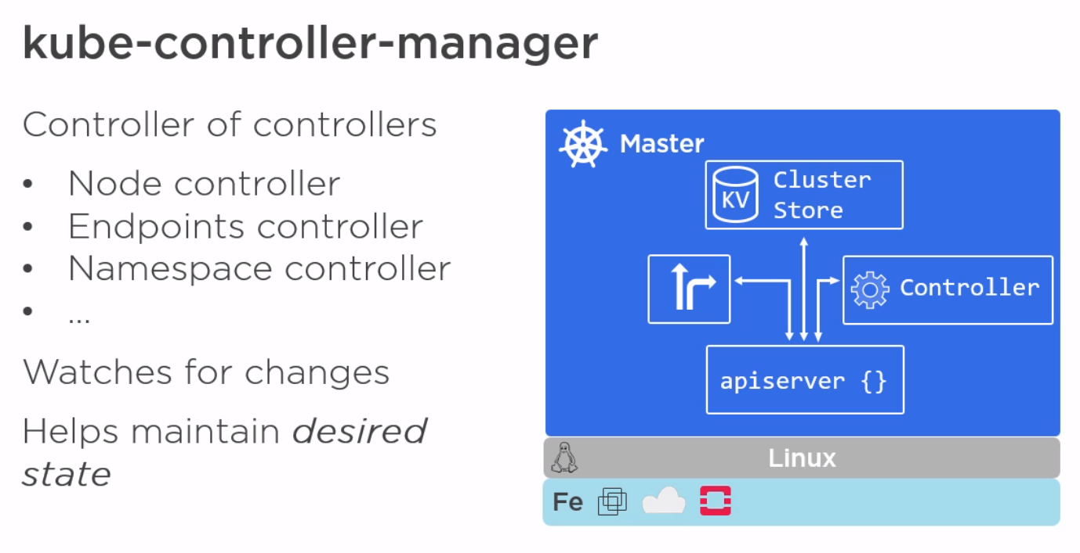
Short about Master

Slide 24
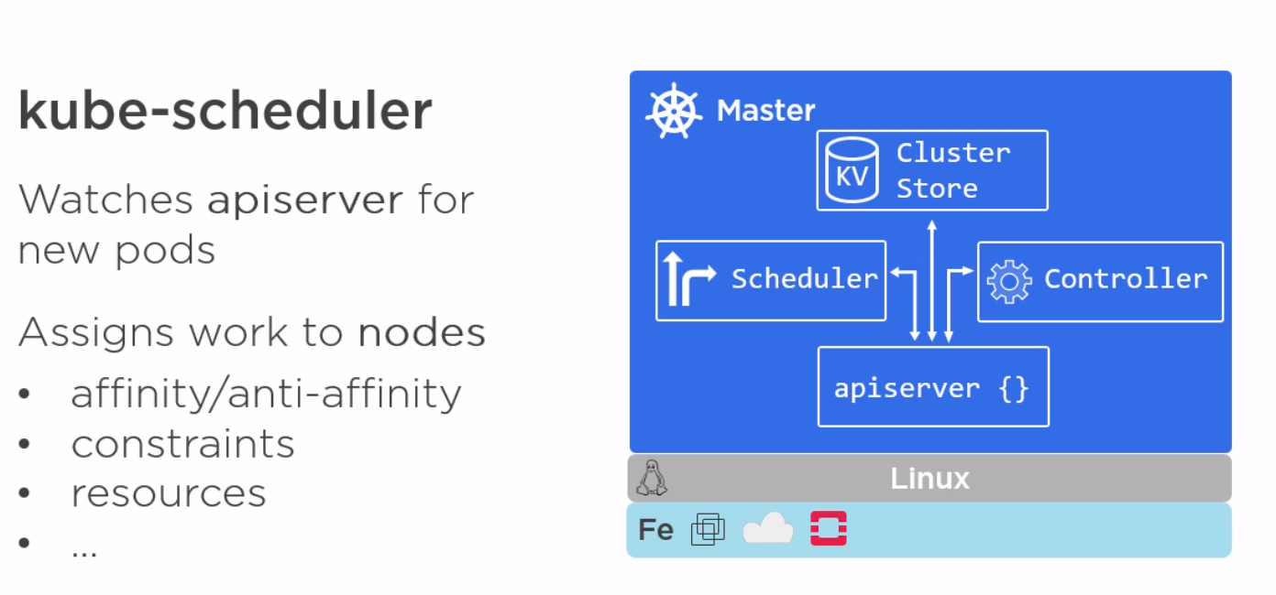
Short about Master

Slide 25
Short about Master

Slide 26
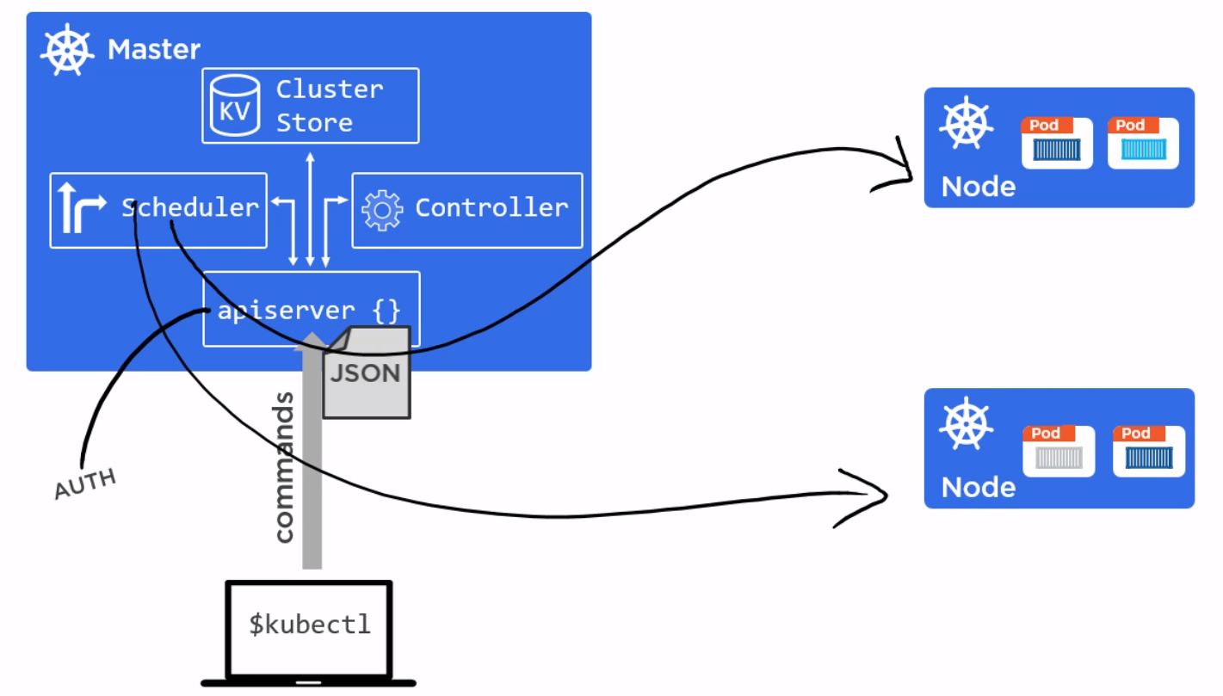
Short about Master

Slide 27
Something about Nodes

Slide 28
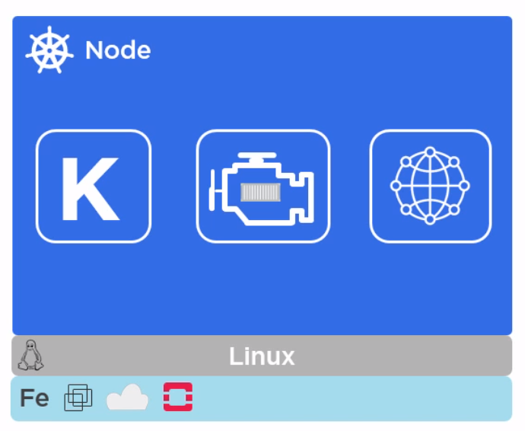
Something about Nodes

Slide 29
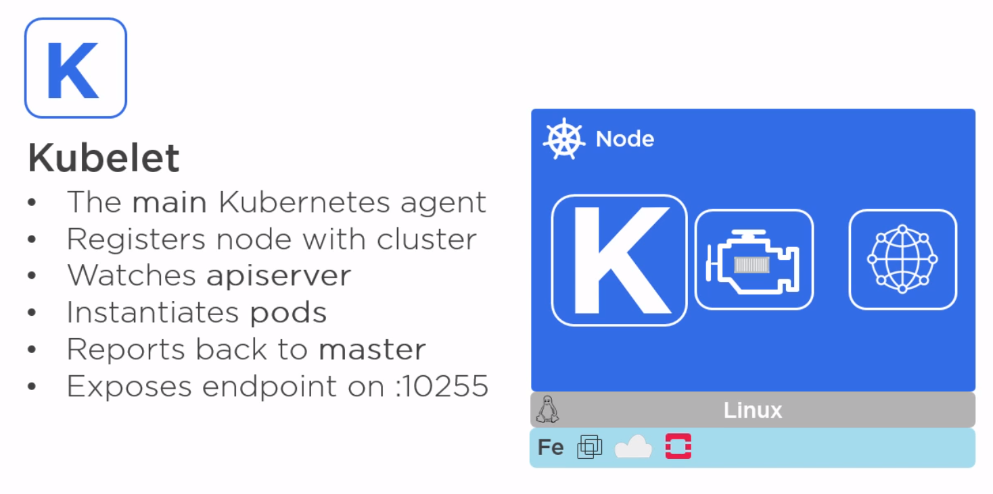
Something about Nodes

Slide 30
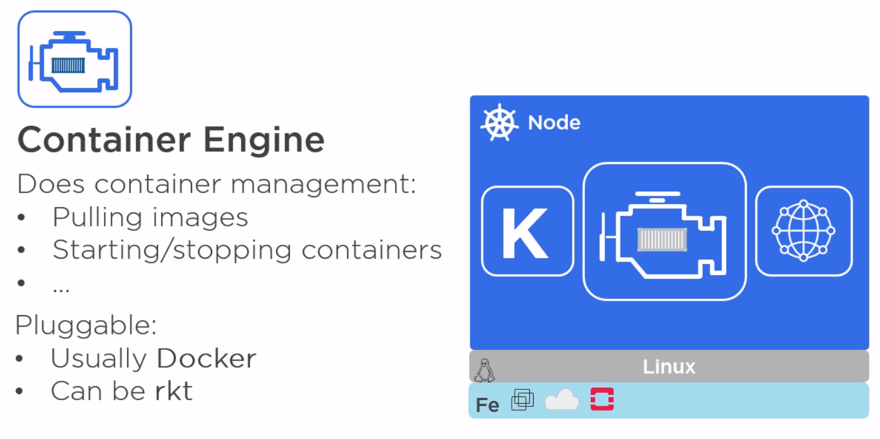
Something about Nodes

Slide 31
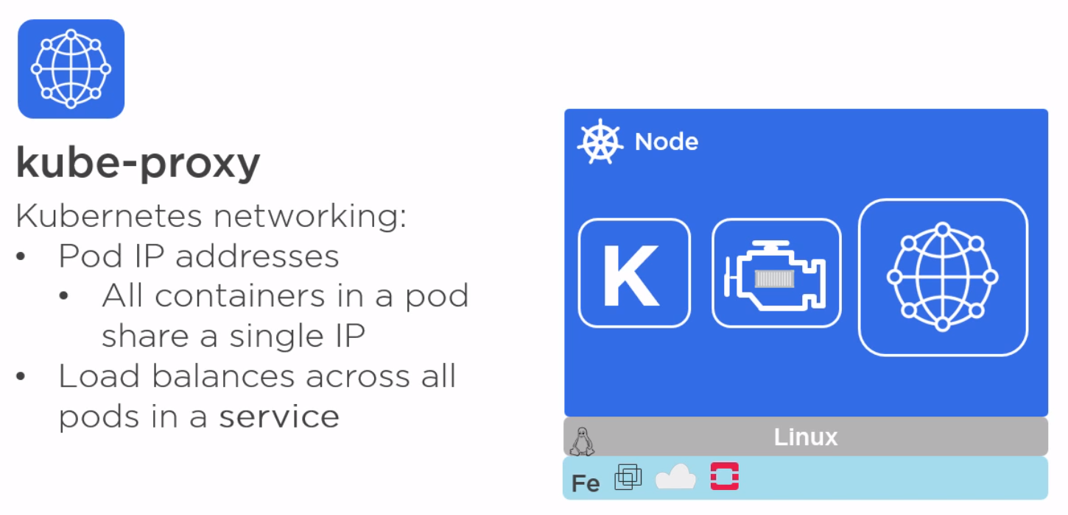
Something about Nodes

Slide 32
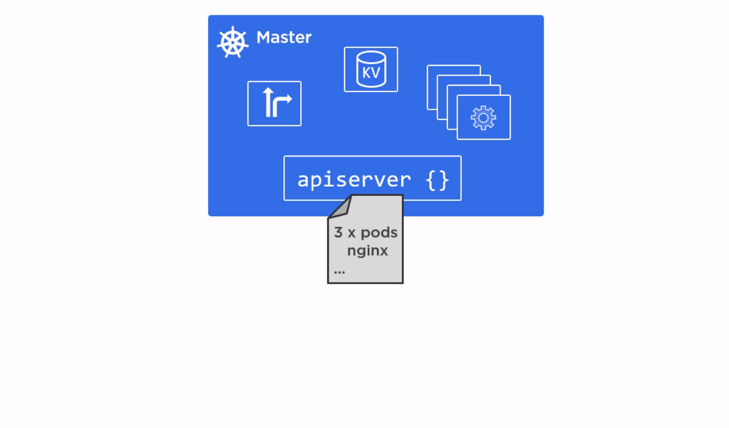
Something about Nodes

Slide 33
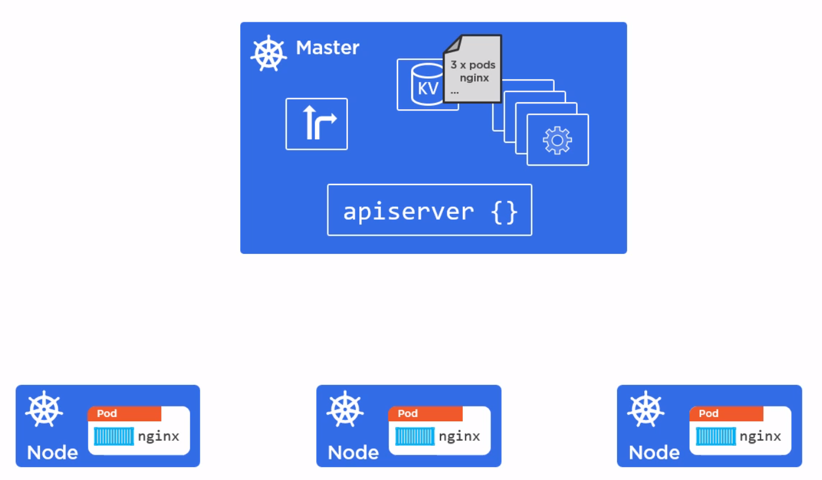
Something about Nodes

Slide 34
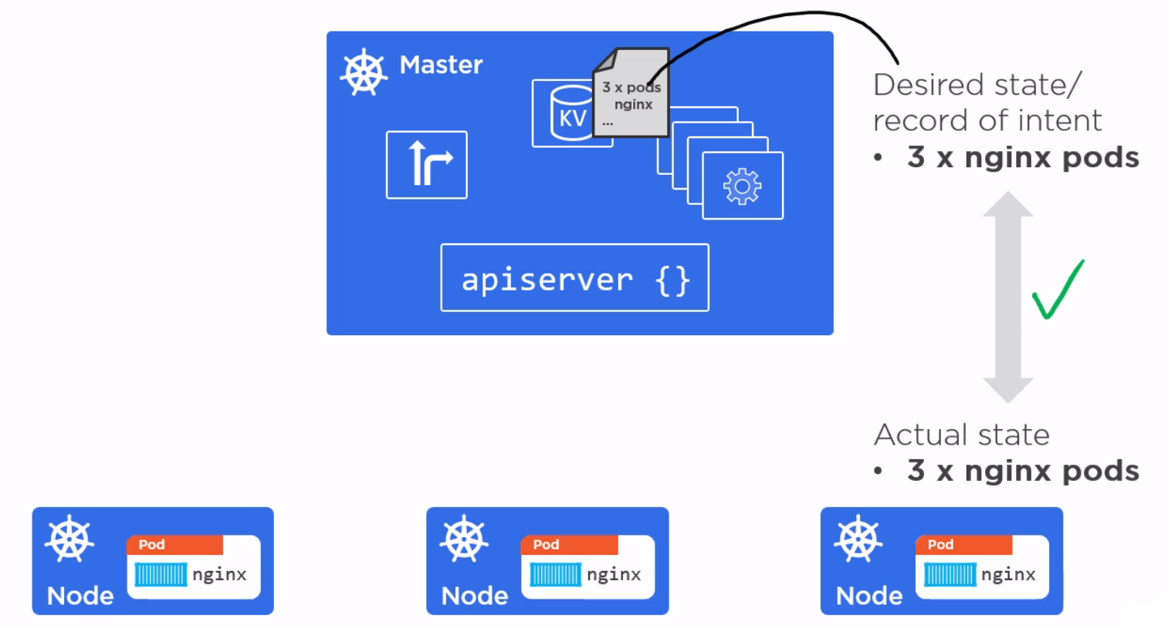
Something about Nodes

Slide 35
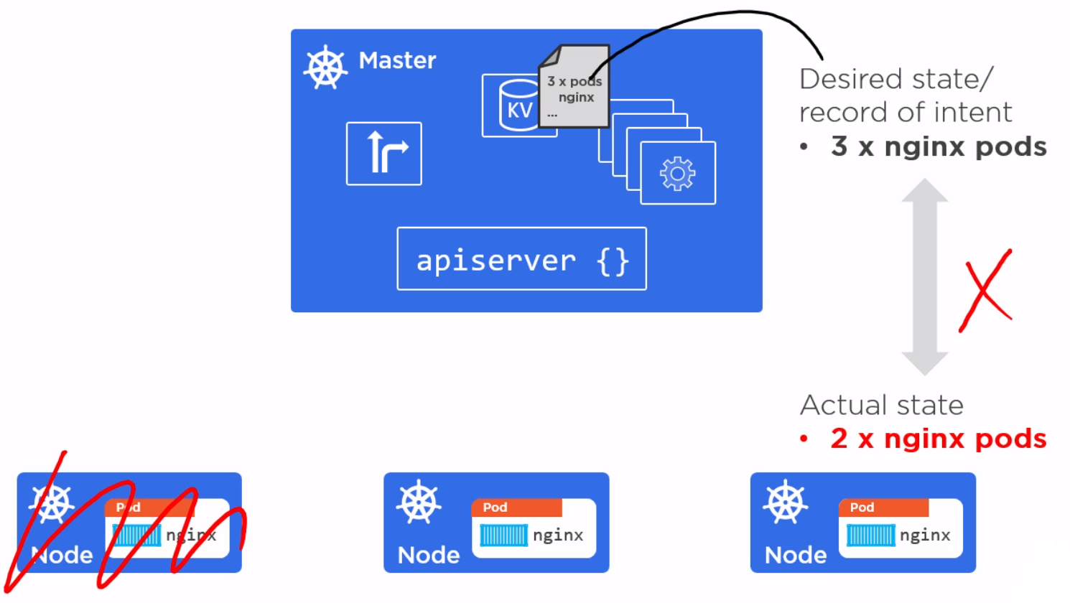
Something about Nodes

Slide 36
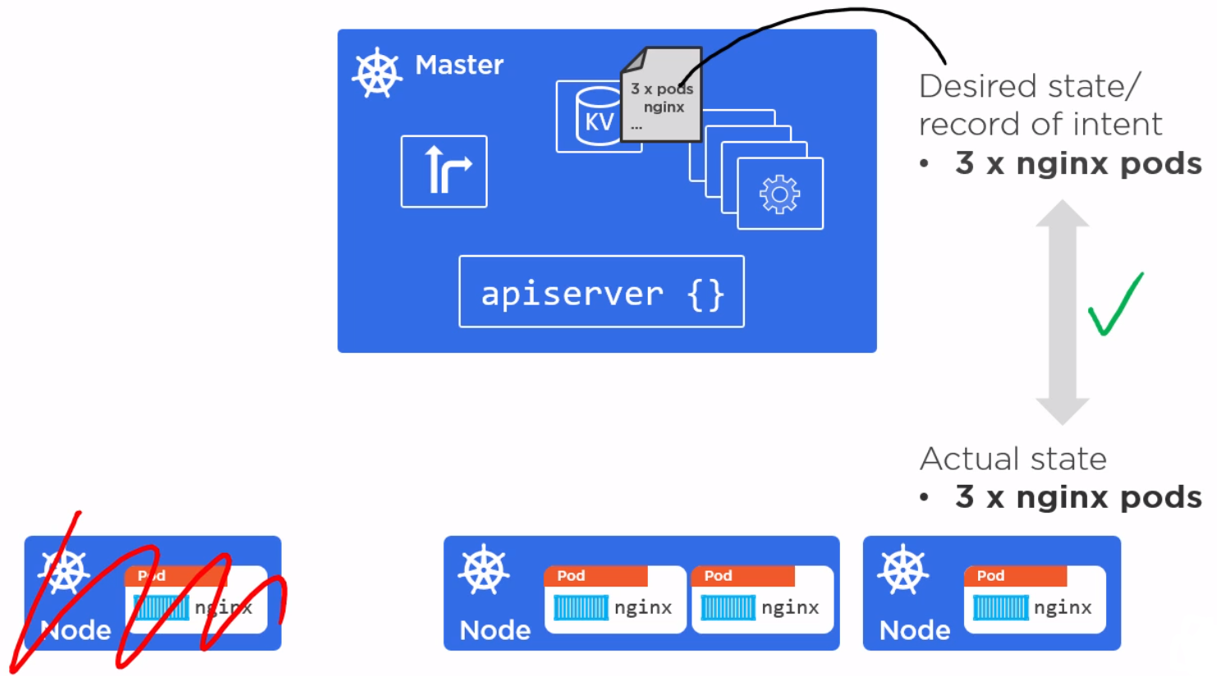
Something about Nodes

Slide 37
Pods Theory & Demo

Slide 38
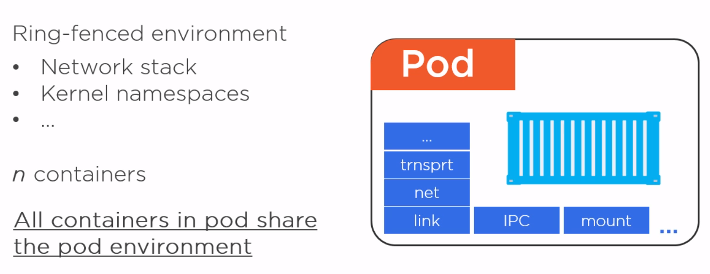
Pods Theory & Demo

Slide 39
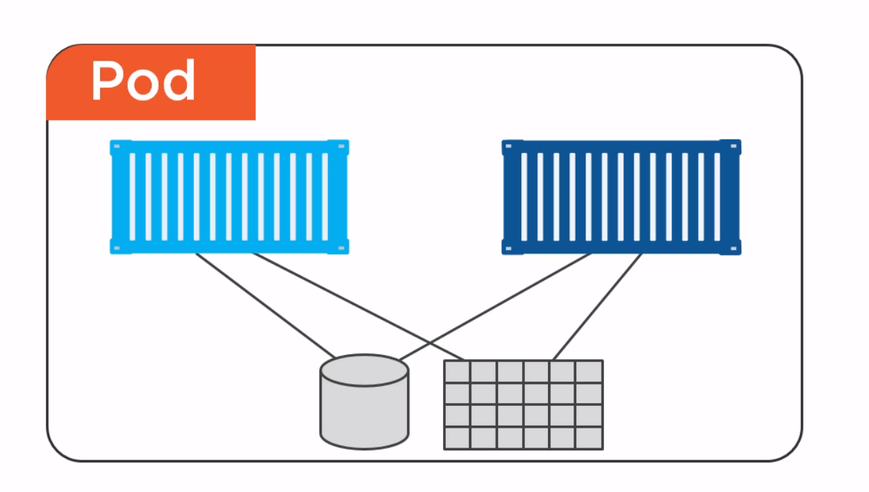
Pods Theory & Demo

Slide 40
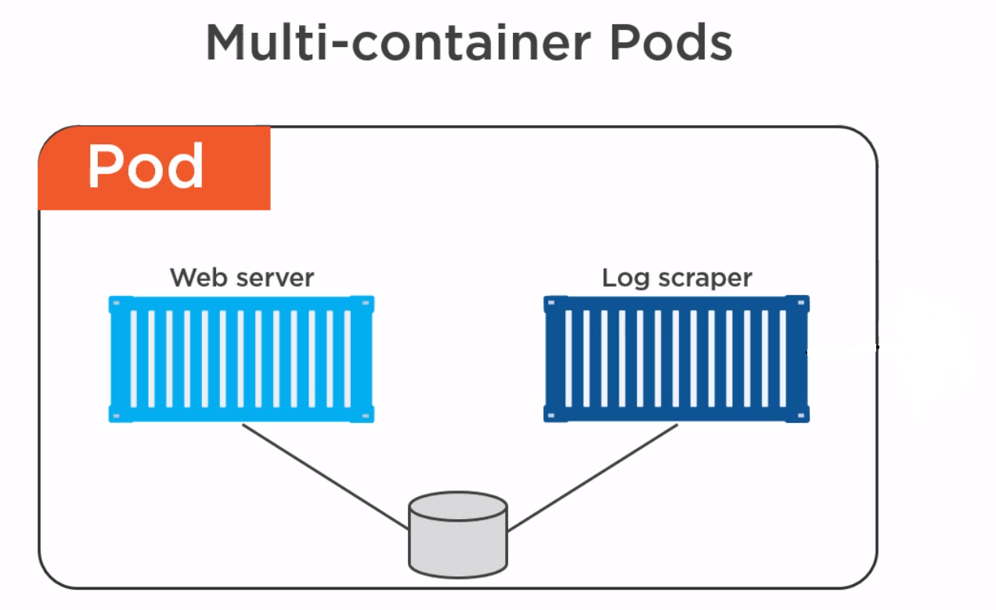
Pods Theory & Demo

Slide 41
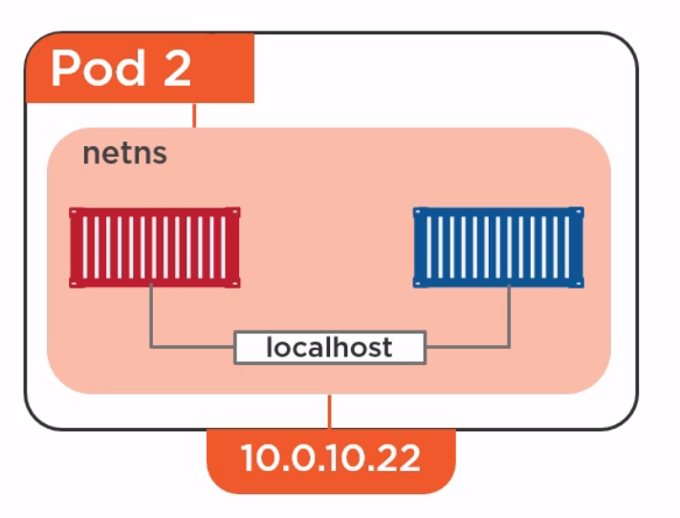
Pods Theory & Demo

Slide 42
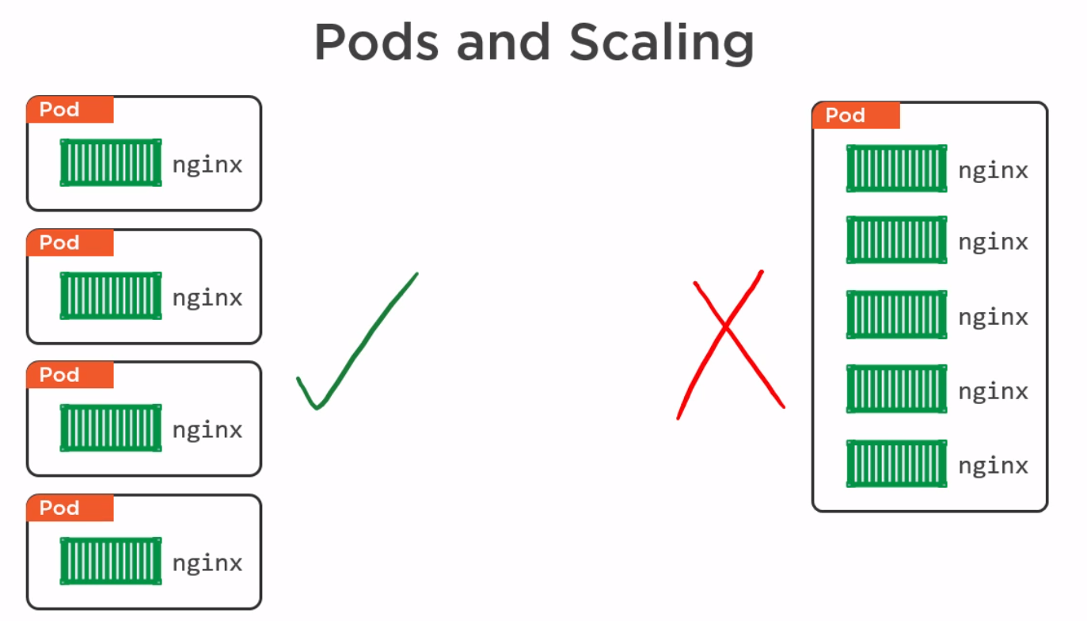
Pods Theory & Demo

Slide 43
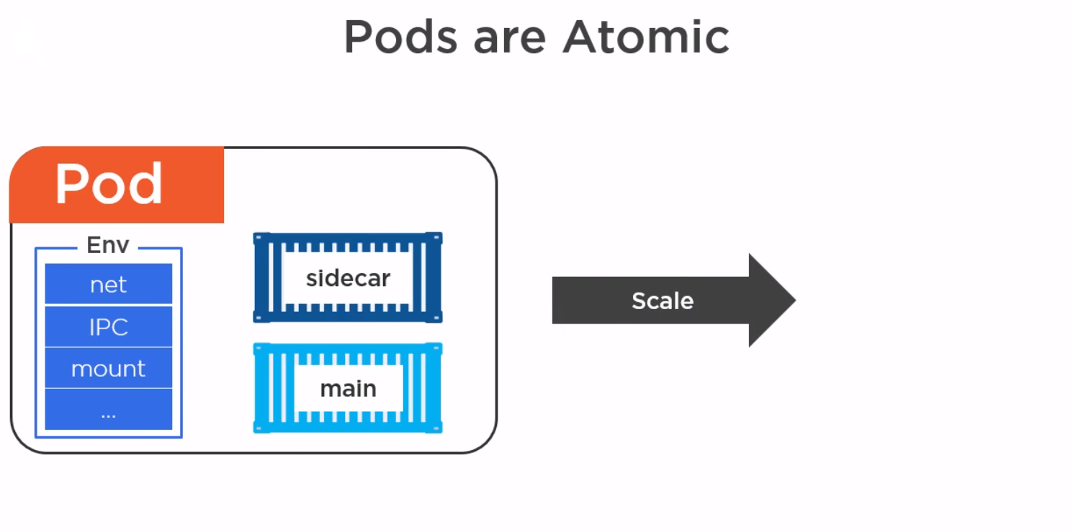
Pods Theory & Demo

Slide 44
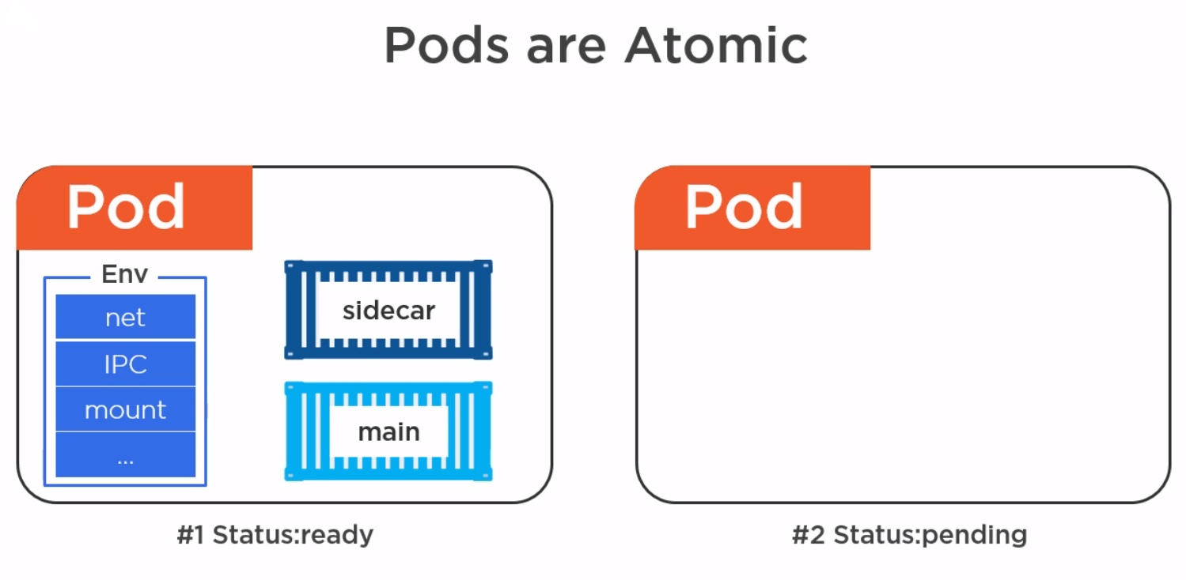
Pods Theory & Demo

Slide 45
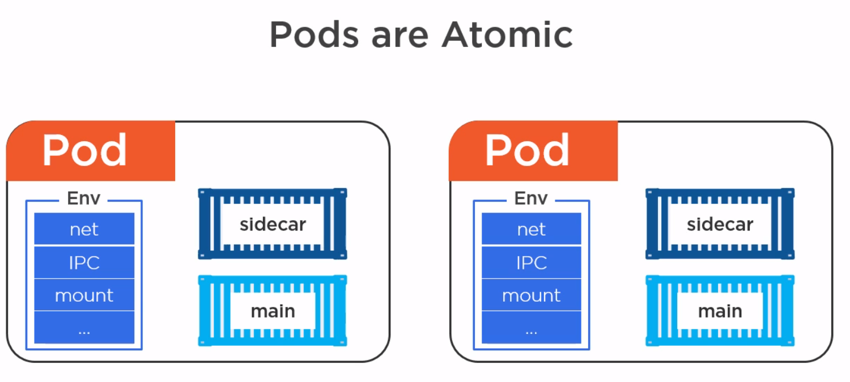
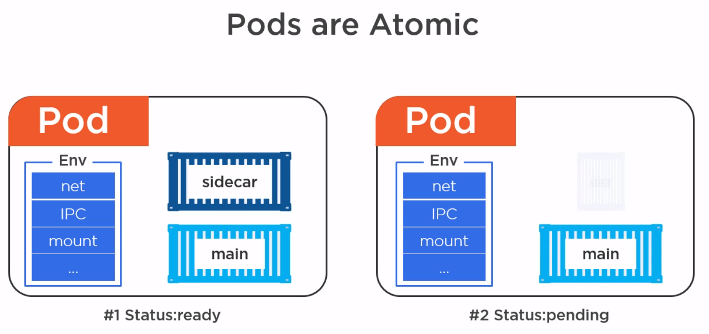
Pods Theory & Demo

Slide 46
Pods Theory & Demo

Slide 47
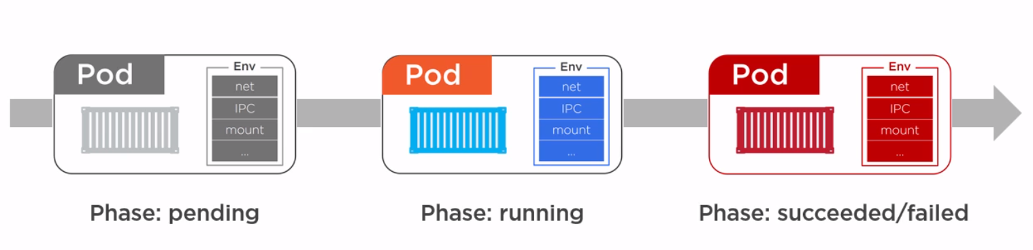
Pods Theory & Demo

Slide 48
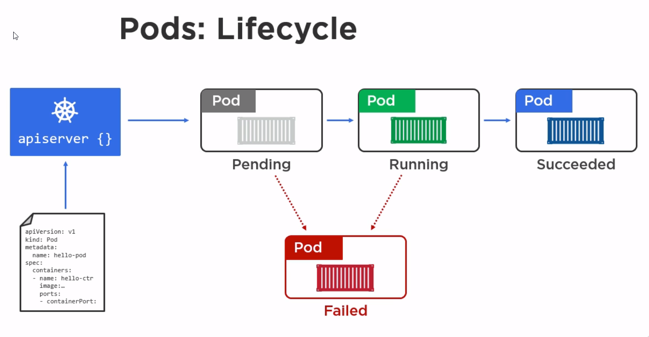
Pods Theory & Demo

Slide 49
RC/SVC Theory & Demo

Slide 50
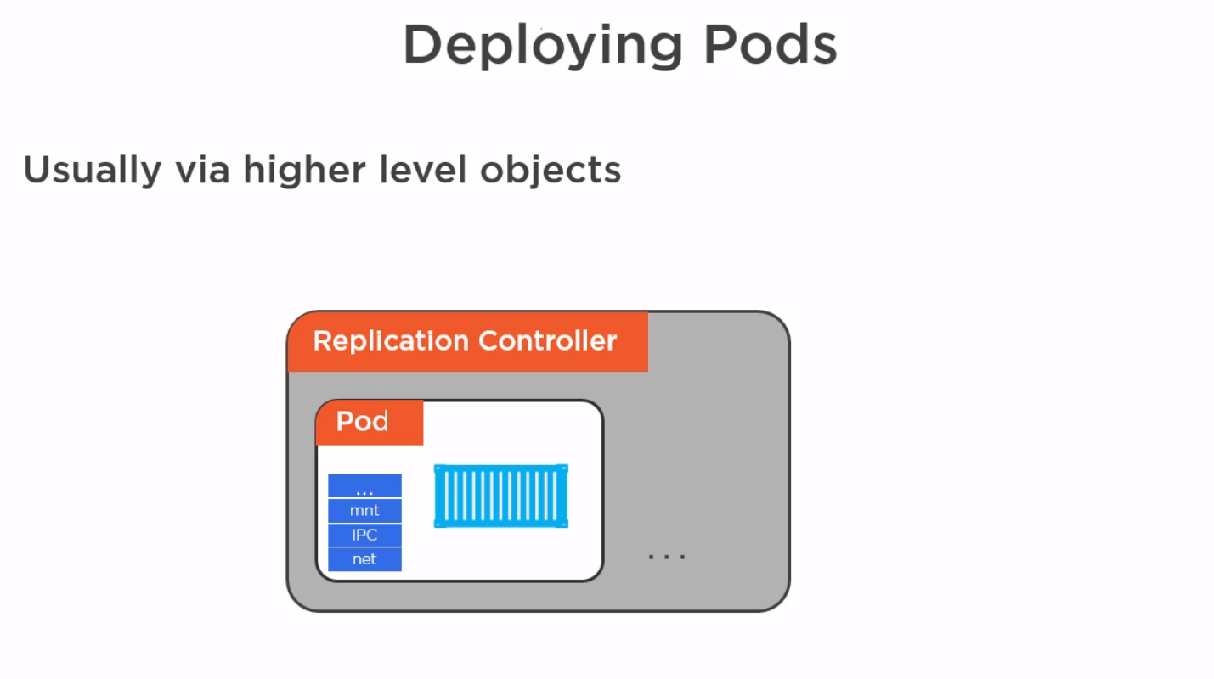
RC/SVC Theory & Demo

Slide 51
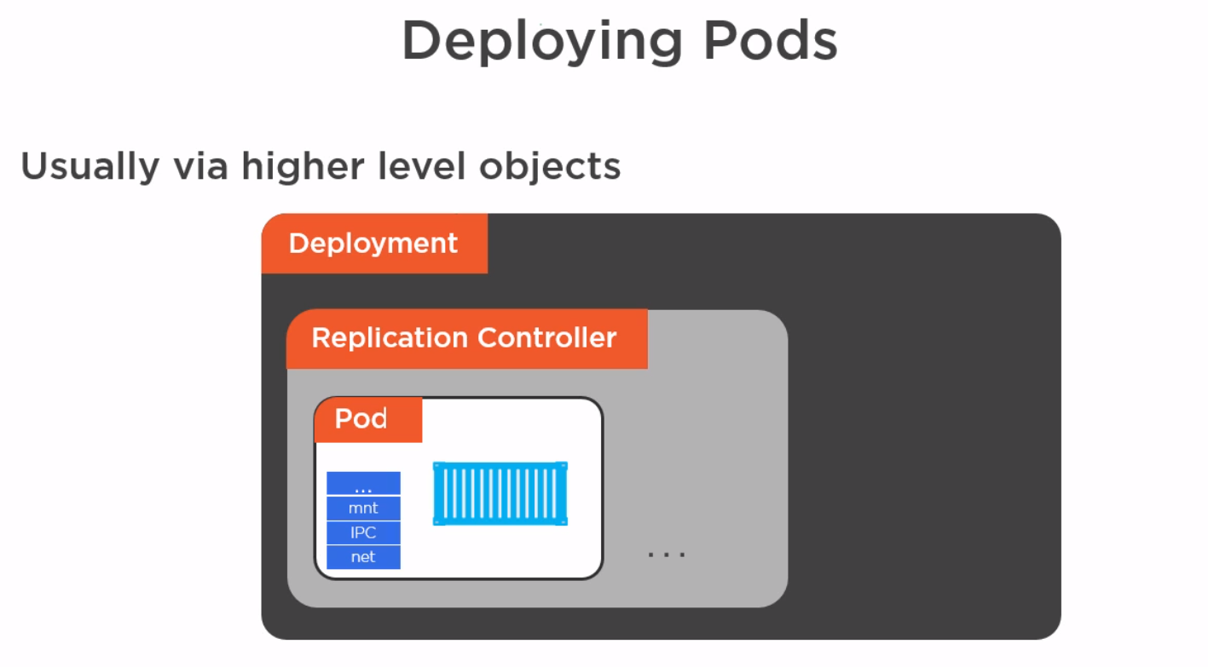
RC/SVC Theory & Demo

Slide 52
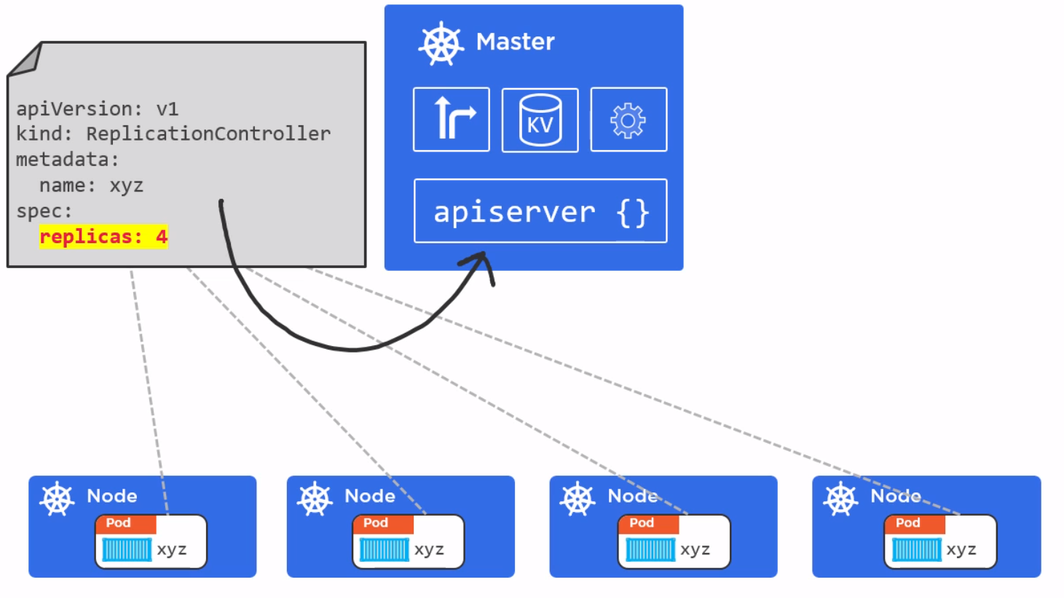
RC/SVC Theory & Demo

Slide 53
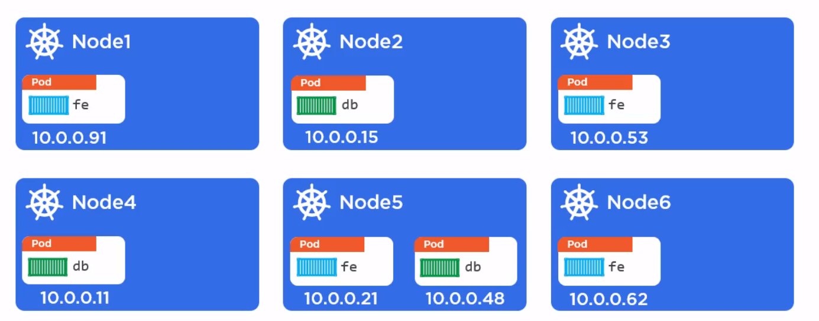
RC/SVC Theory & Demo

Slide 54
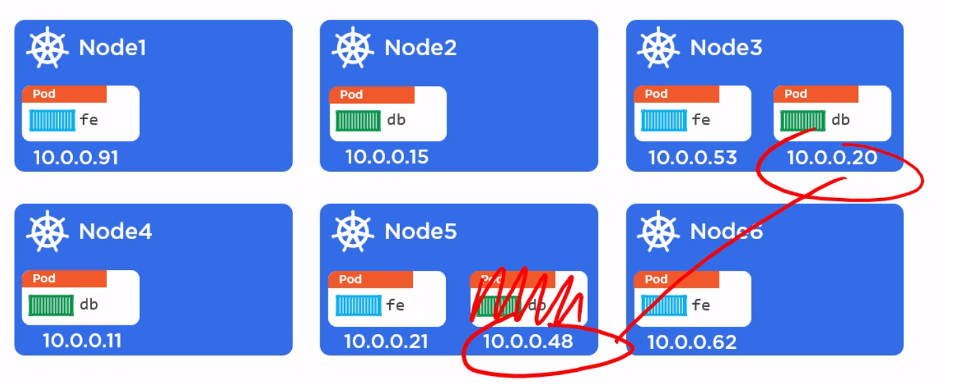
RC/SVC Theory & Demo

Slide 55
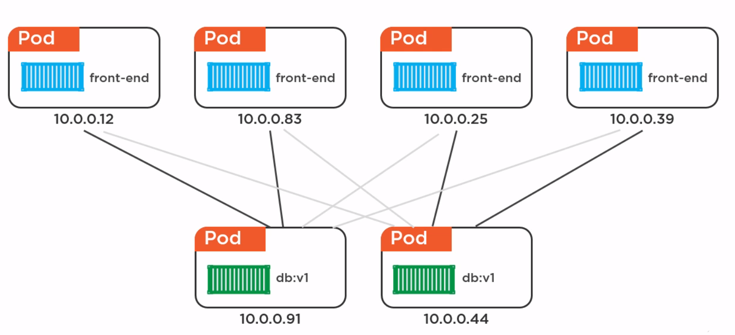
RC/SVC Theory & Demo

Slide 56
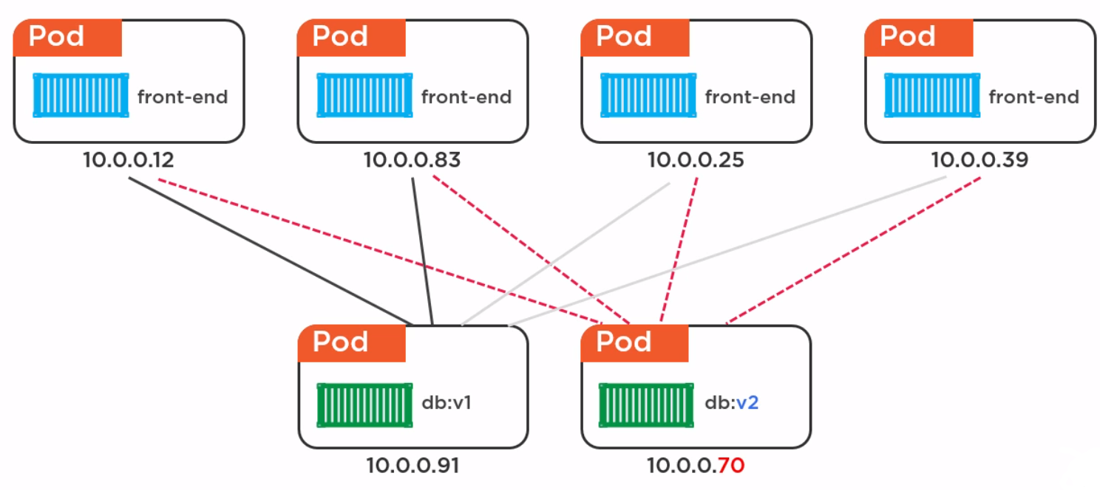
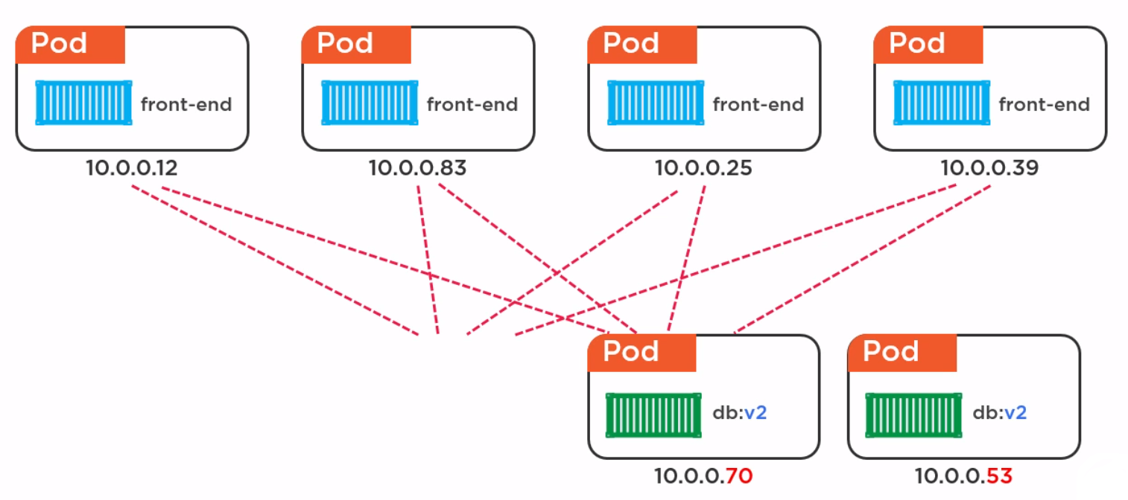
RC/SVC Theory & Demo

Slide 57
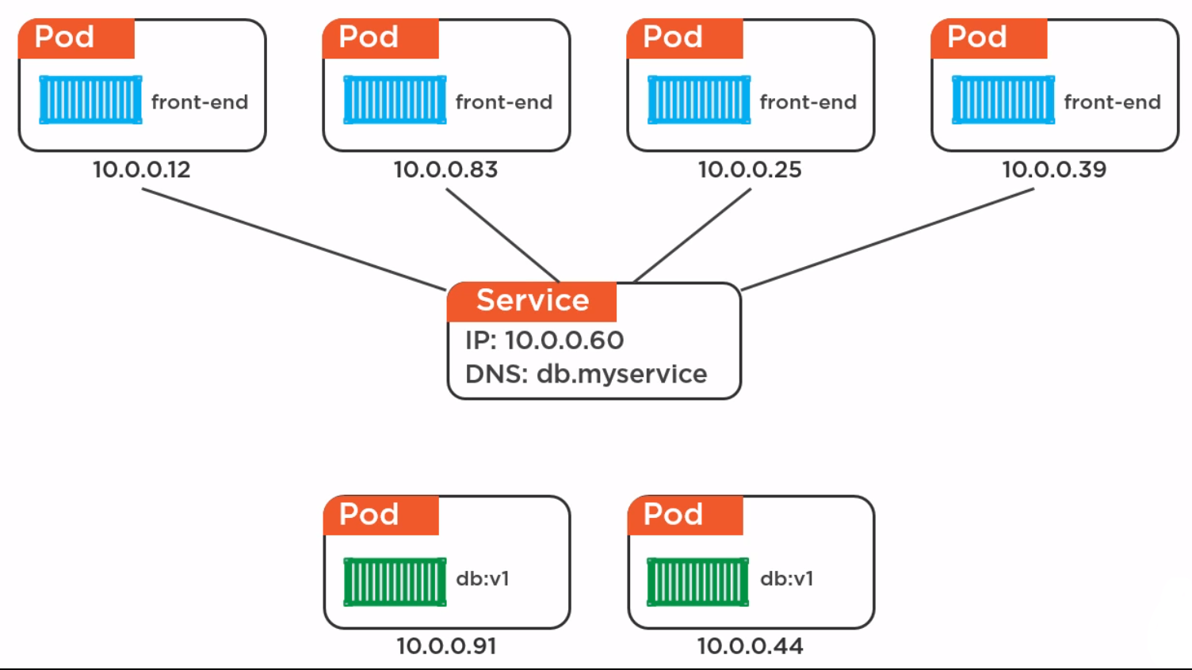
RC/SVC Theory & Demo

Slide 58

RC/SVC Theory & Demo

Slide 59

RC/SVC Theory & Demo

Slide 60

RC/SVC Theory & Demo

Slide 61

RC/SVC Theory & Demo

Slide 62

RC/SVC Theory & Demo

Slide 63

RC/SVC Theory & Demo

Slide 64

RC/SVC Theory & Demo

Slide 65
RC/SVC Theory & Demo

Slide 66

RC/SVC Theory & Demo

Slide 67

RC/SVC Theory & Demo

Slide 68

RC/SVC Theory & Demo

Slide 69

RC/SVC Theory & Demo

Slide 70

RC/SVC Theory & Demo

Slide 71

RC/SVC Theory & Demo

Slide 72

RC/SVC Theory & Demo

Slide 73

RC/SVC Theory & Demo

Slide 74
Deployments Theory & Demo

Slide 75

Deployments Theory & Demo

Slide 76

Deployments Theory & Demo

Slide 77

Deployments Theory & Demo

Slide 78

Deployments Theory & Demo

Slide 79

Deployments Theory & Demo

Slide 80
Some Additional Comparison Slides

Slide 81

Some Additional Comparison Slides

Slide 82

Some Additional Comparison Slides

Slide 83

Some Additional Comparison Slides

Slide 84

Some Additional Comparison Slides

Slide 85

Some Additional Comparison Slides

Slide 86

Some Additional Comparison Slides

Slide 87
Books:

Slide 88
Homework:
Running Web API using Docker and Kubernetes
Pluralsight - Getting Started Kubernetes
Kubernetes the hard way
Official Tutorials
Awesome Kubernetes
Kubernetes Examples

Slide 89


Slide 90
Thank you!
Bohdan Benetskyi· benetskyy - Github

